Slide 1
Statistics: Concepts and Controversies
Chapter 2: Samples, Good and Bad
Lecture Slides

Slide 2
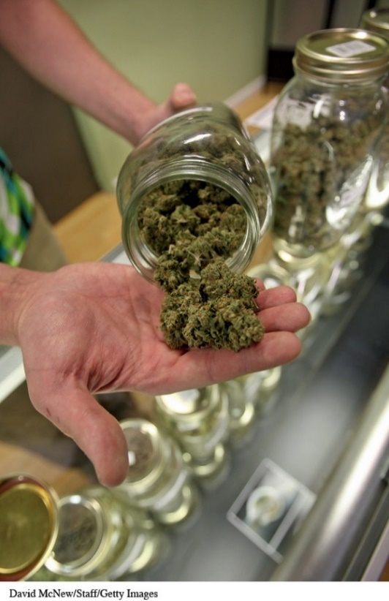
Case Study: Samples, Good and Bad 1
In January 2014 the Michigan news site MLive ran the story, “Take Our Online Poll: Should Michigan Legalize Marijuana?”
Of 9684 respondents,
7906 (81.84%) said, “Yes”
1190 (12.2%) said, “No”
588 (6.07%) said, “Decriminalize but don’t legalize”
This appears to be overwhelming support for legalization.

Slide 3
Case Study: Samples, Good and Bad 2
The Pew Research Center conducted a poll on March 25–29, 2015, in which they asked, “Do you think the use of marijuana should be made legal or not?”
53% of the 1500 randomly selected adult Americans in the survey favor the legal use of marijuana.
This is a majority of those surveyed but not the overwhelming majority that MLive found.
There is a large discrepancy in the findings of these two polls.

Slide 4
Case Study: Samples, Good and Bad 3
The large discrepancy may be because
the polls were conducted at different times
the populations sampled were different (Michigan versus all adult Americans)
the MLive poll had a much larger sample than
the Pew poll
the questions asked were not identical
the data from one or both polls are bad
By the end of this chapter you will have learned how to assess whether the data from these polls are good or bad.

Slide 5
Case Study: Samples, Good and Bad 4
The design of a statistical study is biased if it systematically favors certain outcomes.
Selection of whichever individuals are easiest to reach is called convenience sampling.
A voluntary response sample chooses itself by responding to a general appeal (write-in or call-in opinion polls).
Convenience samples and voluntary response samples are often biased.

Slide 6
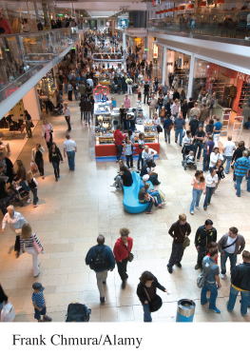
Biased Sampling Methods
Advertising agencies often interview at shopping malls, which is fast and cheap.
People contacted at shopping malls are not representative of the U.S. population. They are richer and more likely to be teenagers or retirees, and the interviewers tend to select neat, safe-looking individuals.

Slide 7
Example: Interviewing at the Mall
Mall samples are biased: they systematically overrepresent some parts of the population (prosperous people, teenagers, and retired people) and underrepresent others.
The opinions of such a convenience sample may be very different from those of the population as a whole.

Slide 8
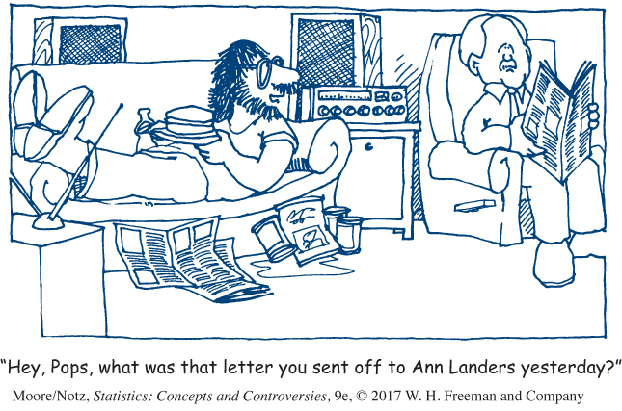
Example: Write-In Opinion Polls
Ann Landers once asked the readers of her advice column, “If you had it to do over again, would you have children?” She received nearly 10,000 responses, almost 70% saying no.
Is it true that 70% of parents regret having children?
No! This is an example of a voluntary response sample, in which the respondents are often those who have a strong and negative opinion.

Slide 9
Simple Random Sample (SRS)
A simple random sample (SRS) of size n consists of n individuals from the population chosen in such a way that every set of n individuals has an equal chance to be the sample actually selected.
Using software, label population elements and draw your sample.

Slide 10
Table of Random Digits 1
A table of random digits is a long string of the digits 0, 1, 2, 3, 4, 5, 6, 7, 8, 9 with these two properties:
Each entry in the table is equally likely to be any of the 10 digits 0 through 9.
The entries are independent of each other. That is, knowledge of one part of the table gives no information about any other part.

Slide 11
Table of Random Digits 2
To select a simple random sample using a table of random digits
Label each population element with as few digits as possible, making sure each label is the same length.
Use the table to select elements.

Slide 12
Table to Generate an SRS
Example: Use random digits to select an SRS of 4 hotels.
01 Aloha Kai 08 Captiva 15 Palm Tree 22 Sea Shell
02 Anchor Down 09 Casa del Mar 16 Radisson 23 Silver Beach
03 Banana Bay 10 Coconuts 17 Ramada 24 Sunset Beach
04 Banyan Tree 11 Diplomat 18 Sandpiper 25 Tradewinds
05 Beach Castle 12 Holiday Inn 19 Sea Castle 26 Tropical Breeze
06 Best Western 13 Lime Tree 20 Sea Club 27 Tropical Shores
07 Cabana 14 Outrigger 21 Sea Grape 28 Veranda

Slide 13


Table to Generate an SRS
Use the random digits provided to select an SRS of 4 hotels.
01 Aloha Kai 08 Captiva 15 Palm Tree 22 Sea Shell
02 Anchor Down 09 Casa del Mar 16 Radisson 23 Silver Beach
03 Banana Bay 10 Coconuts 17 Ramada 24 Sunset Beach
04 Banyan Tree 11 Diplomat 18 Sandpiper 25 Tradewinds
05 Beach Castle 12 Holiday Inn 19 Sea Castle 26 Tropical Breeze
06 Best Western 13 Lime Tree 20 Sea Club 27 Tropical Shores
07 Cabana 14 Outrigger 21 Sea Grape 28 Veranda
69051 64817 87174 09517 84534 06489 87201 97245
69 05 16 48 17 87 17 40 95 17 84 53 40 64 89 87 20
Our SRS of 4 hotels is: 05 Beach Castle, 16 Radisson, 17 Ramada, and 20 Sea Club.

Slide 14
Statistics in Summary 1
We select a sample in order to get information about some population.
How can we choose a sample that fairly represents the population? Convenience samples and voluntary response samples are common but do not produce trustworthy data. These sampling methods are usually biased. That is, they systematically favor some parts of the population over others in choosing the sample.

Slide 15
Statistics in Summary 2
The deliberate use of chance in producing data is one of the big ideas of statistics. Random samples use chance to choose a sample, thus avoiding bias due to personal choice.
The basic type of random sample is the simple random sample, which gives all samples of the same size the same chance to be the sample we actually choose.

Slide 16
Statistics in Summary 3
To choose a simple random sample by hand, use a table of random digits such as Table A in the back of the book, or use software.

